Slide 1
UNIT 3

Slide 2
Exception handling
An exception is a problem that arises during the execution of a program. When an Exception occurs the normal flow of the program is disrupted and the program/Application terminates abnormally, which is not recommended, therefore these exceptions are to be handled
What is Exception in Java?
In Java, an exception is an event that disrupts the normal flow of the program. It is an object which is thrown at runtime.
What is Exception Handling?
Exception Handling is a mechanism to handle runtime errors such as ClassNotFoundException, IOException, SQLException, etc.

Slide 3
Exception is an abnormal condition. An exception can occur for many different reasons, below given are some scenarios where exception occurs.
1.A user has entered invalid data.
2.A file that needs to be opened cannot be found.
3.A network connection has been lost in the middle of communications or the JVM has run out of memory. Some of these exceptions are caused by user error, others by programmer error, and others by physical resources that have failed in some manner.
Advantage of Exception Handling
The core advantage of exception handling is to maintain the normal flow of the application.

Slide 4
statement 1;
statement 2;
statement 3;
statement 4;
statement 5;//exception occurs
statement 6;
statement 7;
statement 8;
statement 9;
statement 10;
Suppose there are 10 statements in a Java program and an exception occurs at statement 5; the rest of the code will not be executed, i.e., statements 6 to 10 will not be executed. However, when we perform exception handling, the rest of the statements will be executed. That is why we use exception handling in Java.

Slide 5
Hierarchy of Java Exception classes
The java.lang.Throwable class is the root class of Java Exception hierarchy inherited by two subclasses: Exception and Error. The hierarchy of Java Exception classes is given below:

Slide 6
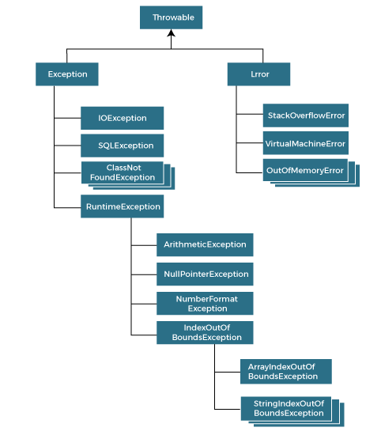

Slide 7
Types of Java Exceptions
There are mainly two types of exceptions: checked and unchecked. An error is considered as the unchecked exception. However, according to Oracle, there are three types of exceptions namely:
1.Checked Exception
2.Unchecked Exception
3.Error

Slide 8
Difference between Checked and Unchecked Exceptions
1) Checked Exception
The classes that directly inherit the Throwable class except RuntimeException and Error are known as checked exceptions. For example, IOException, SQLException, etc. Checked exceptions are checked at compile-time.
2) Unchecked Exception
The classes that inherit the RuntimeException are known as unchecked exceptions. For example, ArithmeticException, NullPointerException, ArrayIndexOutOfBoundsException, etc. Unchecked exceptions are not checked at compile-time, but they are checked at runtime.
3) Error
Error is irrecoverable. Some example of errors are OutOfMemoryError, VirtualMachineError

Slide 9
public class JavaExceptionExample{
public static void main(String args[]){
System.out.println("Exectution start...");
int data=100/0;
System.out.println("rest of the code...");
}
}
Execution start
Exception in thread main java.lang.ArithmeticException:/ by zero

Slide 10
Common Scenarios of Java Exceptions
1) A scenario where ArithmeticException occurs
If we divide any number by zero, there occurs an ArithmeticException.
int a=50/0;//ArithmeticException
2) A scenario where NullPointerException occurs
If we have a null value in any variable, performing any operation on the variable throws a NullPointerException.
String s=null;
System.out.println(s.length());//NullPointerException

Slide 11
3) A scenario where NumberFormatException occurs
If the formatting of any variable or number is mismatched, it may result into NumberFormatException. Suppose we have a string variable that has characters; converting this variable into digit will cause NumberFormatException.
String s="abc";
int i=Integer.parseInt(s);//NumberFormatException
4) A scenario where ArrayIndexOutOfBoundsException occurs
When an array exceeds to it's size, the ArrayIndexOutOfBoundsException occurs. there may be other reasons to occur ArrayIndexOutOfBoundsException. Consider the following statements.
int a[]=new int[5];
a[10]=50; //ArrayIndexOutOfBoundsException

Slide 12
Java Exception Keywords
Java provides five keywords that are used to handle the exception. The following table describes each.
Keyword | Description
try | The "try" keyword is used to specify a block where we should place an exception code. It means we can't use try block alone. The try block must be followed by either catch or finally.
catch | The "catch" block is used to handle the exception. It must be preceded by try block which means we can't use catch block alone. It can be followed by finally block later.
finally | The "finally" block is used to execute the necessary code of the program. It is executed whether an exception is handled or not.
throw | The "throw" keyword is used to throw an exception.
throws | The "throws" keyword is used to declare exceptions. It specifies that there may occur an exception in the method. It doesn't throw an exception. It is always used with method signature.

Slide 13
Java try-catch block
Java try block
Java try block is used to enclose the code that might throw an exception. It must be used within the method.If an exception occurs at the particular statement in the try block, the rest of the block code will not execute. So, it is recommended not to keep the code in try block that will not throw an exception.
Java try block must be followed by either catch or finally block.
Syntax of Java try-catch
try{
//code that may throw an exception
}catch(Exception_class_Name ref){}

Slide 14
Syntax of try-finally block
try{
//code that may throw an exception
}finally{}
Java catch block
Java catch block is used to handle the Exception by declaring the type of exception within the parameter. The declared exception must be the parent class exception ( i.e., Exception) or the generated exception type. However, the good approach is to declare the generated type of exception.
The catch block must be used after the try block only. You can use multiple catch block with a single try block.

Slide 15
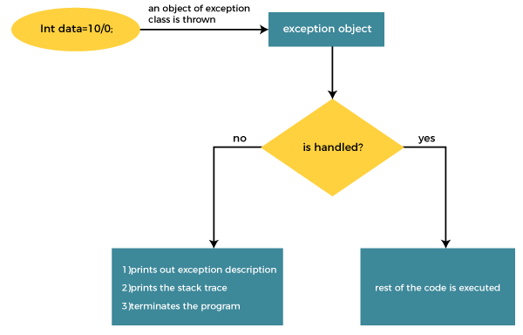
Internal Working of Java try-catch block
The JVM firstly checks whether the exception is handled or not. If exception is not handled, JVM provides a default exception handler that performs the following tasks:
Prints out exception description.
Prints the stack trace (Hierarchy of methods where the exception occurred).
Causes the program to terminate.
But if the application programmer handles the exception, the normal flow of the application is maintained, i.e., rest of the code is executed.

Slide 16
Problem without exception handling
public class TryCatchExample1 {
public static void main(String[] args) {
int data=50/0; //may throw exception
System.out.println("rest of the code");
}
Exception in thread "main" java.lang.ArithmeticException: / by zero

Slide 17
Solution by exception handling
public class JavaExceptionExample{
public static void main(String args[]){
System.out.println("Execution start...");
try{
//code that may raise exception
int data=100/0;
}catch(ArithmeticException e){System.out.println(e);}
//rest code of the program
System.out.println("rest of the code...");
}
}
Execution start
Exception in thread main java.lang.ArithmeticException:/ by zero
rest of the code...

Slide 18
handling the exception using the parent class exception.
public class TryCatchExample4 {
public static void main(String[] args) {
System.out.println("Execution start...");
try
{
int data=50/0; //may throw exception
}
// handling the exception by using Exception class
catch(Exception e)
{
System.out.println(e);
}
System.out.println("rest of the code");
}
}
Execution start...
java.lang.ArithmeticException: / by zero
rest of the code

Slide 19
Example to print a custom message on exception.
public class TryCatchExample5 {
public static void main(String[] args) {
System.out.println(“Execution Starts...”);
try
{
int data=50/0; //may throw exception
}
// handling the exception
catch(Exception e)
{
// displaying the custom message
System.out.println("Can't divided by zero");
}
}
}
Execution Starts...
Can't divided by zero

Slide 20
Example to resolve the exception in a catch block.
public class TryCatchExample6 {
public static void main(String[] args) {
int i=50;
int j=0;
int data;
try
{
data=i/j; //may throw exception
}
// handling the exception
catch(Exception e)
{
// resolving the exception in catch block
System.out.println(i/(j+2)); } } }

Slide 21
handling the generated exception (Arithmetic Exception) with a different type of exception class ArrayIndexOutOfBoundsException).
public class TryCatchExample8 {
public static void main(String[] args) {
try
{
int data=50/0; //may throw exception
}
// try to handle the ArithmeticException using ArrayIndexOutOfBoundsException
catch(ArrayIndexOutOfBoundsException e)
{
System.out.println(e);
}
System.out.println("rest of the code");
}
}

Slide 22
Java Catch Multiple Exceptions
Java Multi-catch block
A try block can be followed by one or more catch blocks. Each catch block must contain a different exception handler. So, if you have to perform different tasks at the occurrence of different exceptions, use java multi-catch block
Points to remember
At a time only one exception occurs and at a time only one catch block is executed.
All catch blocks must be ordered from most specific to most general, i.e. catch for ArithmeticException must come before catch for Exception.

Slide 23
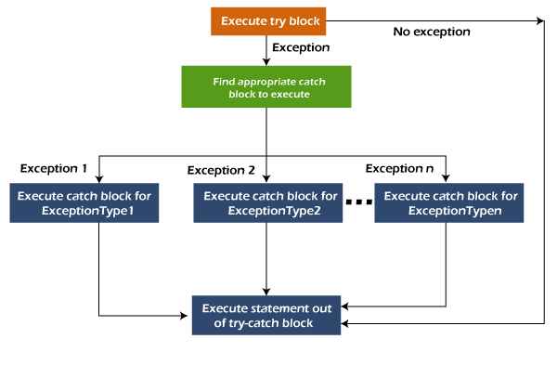
Flowchart of Multi-catch Block

Slide 24
MultipleCatchBlock1.java
public class MultipleCatchBlock1 {
public static void main(String[] args) {
try{
int a[]=new int[5];
a[5]=30/0;
}
catch(ArithmeticException e)
{
System.out.println("Arithmetic Exception occurs");
}
catch(ArrayIndexOutOfBoundsException e)
{
System.out.println("ArrayIndexOutOfBounds Exception occurs");
}
catch(Exception e)
{
System.out.println("Parent Exception occurs");
}
System.out.println("rest of the code");
}
}
Arithmetic Exception occurs
rest of the code

Slide 25
MultipleCatchBlock2.java
public class MultipleCatchBlock2 {
public static void main(String[] args) {
try{
int a[]=new int[5];
System.out.println(a[10]);
}
catch(ArithmeticException e)
{
System.out.println("Arithmetic Exception occurs");
}
catch(ArrayIndexOutOfBoundsException e)
{
System.out.println("ArrayIndexOutOfBounds Exception occurs");
}
catch(Exception e)
{
System.out.println("Parent Exception occurs");
}
System.out.println("rest of the code");
}
}
ArrayIndexOutOfBounds Exception occurs
rest of the code

Slide 26
Example to handle the exception without maintaining the order of exceptions (i.e. from most specific to most general).
class MultipleCatchBlock5{
public static void main(String args[]){
try{
int a[]=new int[5];
a[5]=30/0;
}
catch(Exception e){System.out.println("common task completed");}
catch(ArithmeticException e){System.out.println("task1 is completed");}
catch(ArrayIndexOutOfBoundsException e){System.out.println("task 2 completed");}
System.out.println("rest of the code...");
}
}

Slide 27
Java Nested try block
In Java, using a try block inside another try block is permitted. It is called as nested try block. Every statement that we enter a statement in try block, context of that exception is pushed onto the stack.
For example, the inner try block can be used to handle ArrayIndexOutOfBoundsException while the outer try block can handle the ArithemeticException (division by zero).
Why use nested try block
Sometimes a situation may arise where a part of a block may cause one error and the entire block itself may cause another error. In such cases, exception handlers have to be nested.

Slide 28
Java Nested try Example
//inner try block 2
try{
int a[]=new int[5];
//assigning the value out of array bounds
a[5]=4;
}
//catch block of inner try block 2
catch(ArrayIndexOutOfBoundsException e)
{
System.out.println(e);
}
System.out.println("other statement");
}
public class NestedTryBlock{
public static void main(String args[]){
//outer try block
try{
//inner try block 1
try{
System.out.println("going to divide by 0");
int b =39/0;
}
//catch block of inner try block 1
catch(ArithmeticException e)
{
System.out.println(e);
}

Slide 29
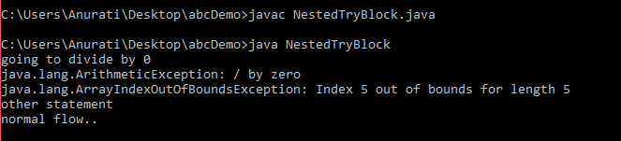
//catch block of outer try block
catch(Exception e)
{
System.out.println("handled the exception (outer catch)");
}
System.out.println("normal flow..");
}
}

Slide 30
Java finally block
Java finally block is a block used to execute important code such as closing the connection, etc.
Java finally block is always executed whether an exception is handled or not. Therefore, it contains all the necessary statements that need to be printed regardless of the exception occurs or not.
The finally block follows the try-catch block.

Slide 31
Why use Java finally block?
finally block in Java can be used to put "cleanup" code such as closing a file, closing connection, etc.
The important statements to be printed can be placed in the finally block.

Slide 32
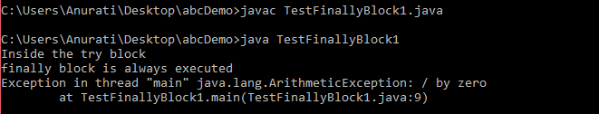
public class TestFinallyBlock1{
public static void main(String args[]){
try {
System.out.println("Inside the try block");
//below code throws divide by zero exception
int data=25/0;
System.out.println(data);
}
//cannot handle Arithmetic type exception
//can only accept Null Pointer type exception
catch(NullPointerException e){
System.out.println(e);
}
//executes regardless of exception occured or not
finally {
System.out.println("finally block is always executed");
}
System.out.println("rest of the code...");
}
}

Slide 33
Java throw Exception
In Java, exceptions allows us to write good quality codes where the errors are checked at the compile time instead of runtime and we can create custom exceptions making the code recovery and debugging easier.
Java throw keyword
The Java throw keyword is used to throw an exception explicitly.
We specify the exception object which is to be thrown. The Exception has some message with it that provides the error description. These exceptions may be related to user inputs, server, etc.
We can throw either checked or unchecked exceptions in Java by throw keyword. It is mainly used to throw a custom exception

Slide 34
We can also define our own set of conditions and throw an exception explicitly using throw keyword. For example, we can throw ArithmeticException if we divide a number by another number. Here, we just need to set the condition and throw exception using throw keyword.
throw new exception_class("error message");
throw new IOException("sorry device error");

Slide 35
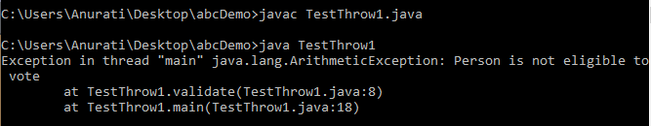
public class TestThrow1 {
//function to check if person is eligible to vote or not
public static void validate(int age) {
if(age<18) {
//throw Arithmetic exception if not eligible to vote
throw new ArithmeticException("Person is not eligible to vote");
}
else {
System.out.println("Person is eligible to vote!!");
}
}
//main method
public static void main(String args[]){
//calling the function
validate(13);
System.out.println("rest of the code...");
}
}

Slide 36
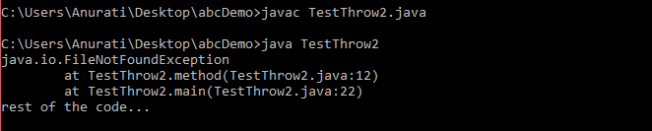
If we throw a checked exception using throw keyword, it is must to handle the exception using catch block or the method must declare it using throws declaration.
//main method
public static void main(String args[]){
try
{
method();
}
catch (FileNotFoundException e)
{
e.printStackTrace();
}
System.out.println("rest of the code...");
}
}
import java.io.*;
public class TestThrow2 {
//function to open a file
public static void method() throws FileNotFoundException
{
FileReader file = new FileReader("C:\\Users
\\Anurati\\Desktop\\abc.txt");
BufferedReader fileInput = new BufferedReader(file);
throw new FileNotFoundException();
}

Slide 37
Methods to print the Exception information:
1. printStackTrace()
This method prints exception information in the format of the Name of the exception: description of the exception, stack trace.
import java.io.*;
class GFG {
public static void main (String[] args) {
int a=5;
int b=0;
try{
System.out.println(a/b);
}
catch(ArithmeticException e){
e.printStackTrace();
} } }
java.lang.ArithmeticException: / by zero
at GFG.main(File.java:8)

Slide 38
2. toString()
The toString() method prints exception information in the format of the Name of the exception: description of the exception.
import java.io.*;
class GFG1 {
public static void main (String[] args) {
int a=5;
int b=0;
try{
System.out.println(a/b);
}
catch(ArithmeticException e){
System.out.println(e.toString());
}
} }
java.lang.ArithmeticException: / by zero

Slide 39
3. getMessage()
The getMessage() method prints only the description of the exception.
import java.io.*;
class GFG1 {
public static void main (String[] args) {
int a=5;
int b=0;
try{
System.out.println(a/b);
}
catch(ArithmeticException e){
System.out.println(e.toString());
}
} }
/ by zero

Slide 40
User-Defined Exceptions
Sometimes, the built-in exceptions in Java are not able to describe a certain situation. In such cases, the user can also create exceptions which are called ‘user-defined Exceptions’.
1) Create the new exception class extending Exception class
2) create a public constructor for a new class with string type of parameter
3) pass the string parameter to the super class
4) declare the exception at the method level

Slide 41
5) create try block inside that create a new exception and throw it based on some condition
6) write a catch block and use some predefined exceptions
7) write the optionally finally block

Slide 42
import java.util.Scanner;
class ExceptionDemo extends Exception{
public ExceptionDemo(String str) {
super(str);
}
public static void main(String args[]) throws ExceptionDemo
{
try {
Scanner sc = new Scanner(System.in) ;
System.out.println("Enter your Age");
int age=sc.nextInt();
if(age<18) {
throw new ExceptionDemo("You are not eligible for vote");
}
else {
System.out.println("You are eligible for vote");
}
}
catch(ExceptionDemo ed) {
ed.printStackTrace();
} } }
C:\Users\MRUH\Desktop\javaex>java ExceptionDemo
Enter your Age
17
ExceptionDemo: You are not eligible for vote
at ExceptionDemo.main(ExceptionDemo.java:15)

Slide 43
Java Exception Propagation
An exception is first thrown from the top of the stack and if it is not caught, it drops down the call stack to the previous method. If not caught there, the exception again drops down to the previous method, and so on until they are caught or until they reach the very bottom of the call stack. This is called exception propagation.
By default Unchecked Exceptions are forwarded in calling chain (propagated).

Slide 44
class TestExceptionPropagation1{
void m(){
int data=50/0;
}
void n(){
m();
}
void p(){
try{
n();
}catch(Exception e){System.out.println("exception handled");}
}
public static void main(String args[]){
TestExceptionPropagation1 obj=new TestExceptionPropagation1();
obj.p();
System.out.println("normal flow...");
}
}
exception handled
normal flow...

Slide 45
By default, Checked Exceptions are not forwarded in calling chain (propagated).
class TestExceptionPropagation2{
void m(){
throw new java.io.IOException("device error");//checked exception
}
void n(){
m();
}
void p(){
try{
n();
}catch(Exception e){System.out.println("exception handeled");}
}
public static void main(String args[]){
TestExceptionPropagation2 obj=new TestExceptionPropagation2();
obj.p();
System.out.println("normal flow");
}
}
TestExceptionPropagation2.java:3: error: unreported exception IOException; must be caught or declared to be thrown
throw new java.io.IOException("device error");//checked exception
^
1 error

Slide 46
Java throws keyword
The Java throws keyword is used to declare an exception. It gives an information to the programmer that there may occur an exception. So, it is better for the programmer to provide the exception handling code so that the normal flow of the program can be maintained.
Exception Handling is mainly used to handle the checked exceptions. If there occurs any unchecked exception such as NullPointerException, it is programmers' fault that he is not checking the code before it being used.
return_type method_name() throws exception_class_name{
//method code
}

Slide 47
Which exception should be declared?
Ans: Checked exception only, because:
Unchecked exception: under our control so we can correct our code.
error: beyond our control.
For example, we are unable to do anything if there occurs VirtualMachineError or StackOverflowError.

Slide 48
import java.io.IOException;
class Testthrows1{
void m()throws IOException{
throw new IOException("device error");//checked exception
}
void n()throws IOException{
m();
}
void p(){
try{
n();
}catch(Exception e){System.out.println("exception handled");}
}
public static void main(String args[]){
Testthrows1 obj=new Testthrows1();
obj.p();
System.out.println("normal flow...");
}
}
exception handled
normal flow...

Slide 49
If we are calling a method that declares an exception, we must either caught or declare the exception.
There are two cases:
Case 1: We have caught the exception i.e. we have handled the exception using try/catch block.
Case 2: We have declared the exception i.e. specified throws keyword with the method.

Slide 50
Case 1: Handle Exception Using try-catch block
In case we handle the exception, the code will be executed fine whether exception occurs during the program or not.
import java.io.*;
class M{
void method()throws IOException{
throw new IOException("device error");
}
}
public class Testthrows2{
public static void main(String args[]){
try{
M m=new M();
m.method();
}catch(Exception e){System.out.println("exception handled");}
System.out.println("normal flow...");
}
}
exception handled
normal flow...

Slide 51
Case 2: Declare Exception
In case we declare the exception, if exception does not occur, the code will be executed fine.
In case we declare the exception and the exception occurs, it will be thrown at runtime because throws does not handle the exception.
import java.io.*;
class M{
void method()throws IOException{
System.out.println("device operation performed");
}
}
class Testthrows3{
public static void main(String args[])throws IOException{//declare exception
M m=new M();
m.method();
System.out.println("normal flow...");
}
}
device operation performed
normal flow...

Slide 52

import java.io.*;
class M{
void method()throws IOException{
throw new IOException("device error");
}
}
class Testthrows4{
public static void main(String args[])throws IOException{//declare exception
M m=new M();
m.method();
System.out.println("normal flow...");
}
}

Slide 53
Difference between throw and throws in Java
Basis of Differences | throw | throws
Definition | Java throw keyword is used throw an exception explicitly in the code, inside the function or the block of code. | Java throws keyword is used in the method signature to declare an exception which might be thrown by the function while the execution of the code.
Type of exception | Using throw keyword, we can only propagate unchecked exception i.e., the checked exception cannot be propagated using throw only. | Using throws keyword, we can declare both checked and unchecked exceptions. However, the throws keyword can be used to propagate checked exceptions only.
Syntax | The throw keyword is followed by an instance of Exception to be thrown. | The throws keyword is followed by class names of Exceptions to be thrown.
Declaration | throw is used within the method. | throws is used with the method signature.
Internal implementation | We are allowed to throw only one exception at a time i.e. we cannot throw multiple exceptions. | We can declare multiple exceptions using throws keyword that can be thrown by the method. For example, main() throws IOException, SQLException.

Slide 54
Multithreading in Java
What is Single-Tasking?
Single-Tasking means executing one task at a time. Here much of the processor time will be wasted because waiting time is very high and the processor gives a late response. Example: DOS
What is Multitasking?
Windows operating system is a multitasking operating system. It means it has the ability to run multiple applications at the same time. For example, in my machine,I can open the Google Chrome Browser, Microsoft word document, Notepad,VLC Media Player, Windows Explorer, etc. at the same time. This is possible because on my machine I have installed the Windows operating system and the Windows operating system is a multitasking operating system.

Slide 55
Types of Multi-Tasking
We can achieve multitasking in the following two ways:
1. Processor-based multitasking (Multiprocessing)
2. Thread-based multitasking (Multithreading)
Processor-based multitasking (Multiprocessing)
Processor-based multitasking means executing multiple tasks at the same time simultaneously where each task is independent of other tasks having separate memory and resources. Processor-based multitasking is an operating system approach.

Slide 56
Thread-based multitasking (Multithreading)
Thread-based multitasking means executing different parts of the same program at the same time simultaneously where each task is independent sometimes or dependent sometimes on other tasks which are having common memory and resources.
Understanding some terminology:
Time Slice / Time Quantum:
For executing each task a unit of CPU time is given for its execution which is
called a time slice or time quantum. The thread scheduler runs each thread for a short amount of time. Each thread alternatively gets a slice (quantum) of the CPU’s time.

Slide 57
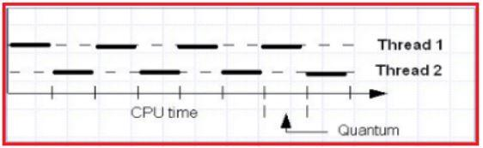
Thread Scheduler :
Thread Scheduler is the Operating System program that is responsible for allocating the resources for threads and executing them. Thread Scheduler in java is the part of the JVM that decides which thread should run. There is no guarantee that which runnable thread will be chosen to run by the thread scheduler. Only one thread at a time can run in a single process. The thread scheduler mainly uses preemptive or time-slicing scheduling to schedule the threads

Slide 58
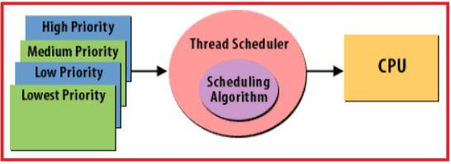
Advantages of Multitasking:
Whether it is a process-based or thread-based multitasking the advantage of multitasking is to improve the performance of the system by decreasing the response time.
Note: In general process-based multitasking is called just multitasking and
thread-based multitasking is called multithreading.

Slide 59
The Difference between Multitasking and Multithreading is:
Multitasking is heavyweight because switching between contexts is slow as each process is stored at a separate address. Multi-threading is lightweight because switching between contexts is fast as each thread is stored in the same address as we already discussed.
What are Java Threads?
We can consider JVM is also a process, when JVM is created in its java stack
area by default two threads are created with names
1. Main- to execute the java methods
2. Garbage collector- to destroy unreferenced objects

Slide 60
What are Sequential execution and concurrent execution?
Sequential execution means single-thread execution and it takes more time to complete all methods of execution. Whereas concurrent execution means
multithreading execution and it takes less time to complete all methods of
execution. To have concurrent execution developers must create user-defined threads in the program
What is Thread?
Generally, a Thread is a lightweight process. In simple words, we can say that a Thread is a unit of a process that is responsible for executing the application code.So, every program or application has some logic or code, and to execute that logic or code, Thread comes into the picture.

Slide 61
Advantages of Java Multithreading:
1. The users are not blocked because threads are independent, and we can
perform multiple operations at times
2. As such the threads are independent, the other threads won’t get affected if one thread meets an exception
Why do we need multithreading in Java?
We need multithreading mainly for two reasons.
1. To complete the execution of independent multiple tasks in a short time
2. To effectively utilize the CPU’s ideal time.

Slide 62
public class TestMultiThreading
{
public static void main (String[] args)
{
System.out.println(Thread.currentThread().getName());
System.out.println(Thread.activeCount());
System.out.println(Thread.currentThread().getId());
System.out.println(Thread.currentThread().getPriority());
}
}
Output
main
1
1
5

Slide 63
class mul extends Thread
{
public void run()
{
int a=5,b=10;
int c=a+b;
System.out.println(c);
}
}
class mul1 extends Thread
{
public void run()
{
int a=5,b=10;
int c=a*b;
System.out.println(c);
}
}
public class multt
{
public static void main (String[] args)
{
mul t1=new mul();
mul1 t2=new mul1();
t1.start();
t2.start();
}
}
15
50

Slide 64
What are the Different Ways to Create Custom Threads in Java?
In java, we can create user-defined threads in two ways
1. Implementing Runnable interface
2. Extending Thread Class
1.Creating Thread by extending Thread class
Step-1: Creating a class that extends a Thread class
class Mythread extends thread{ }
Step-2 Overriding the run() method
public void run(){ //statements; }
Here, the run() method is called the entry-point for the user-defined thread, and all the jobs are done by the user-defined thread will be written here itself.

Slide 65
Step-3: Creating an object for user-defined Thread class
MyThread the = new MyThread();
Step-4: Attaching user-defined Thread with main ThreadGroup
Thread t = new Thread(mt);
Step-5: Starting user-defined Thread by calling the start() method
t.start();

Slide 66
class MyThread extends Thread
{
public void run ()
{
for (int i = 1; i <= 10; i++)
output
User Thread Value: 1
User Thread Value: 2
User Thread Value: 3
User Thread Value: 4
User Thread Value: 5
User Thread Value: 6
User Thread Value: 7
User Thread Value: 8
User Thread Value: 9
User Thread Value: 10
{
System.out.println ("User Thread Value:" + i);
}
}
}
public class MyThread2
{
public static void main (String[]args)
{
MyThread mt = new MyThread ();
Thread t = new Thread (mt);
t.start ();
} }

Slide 67
class multd1 implements Runnable
{
public void run()
{
int a=10,b=5,c;
c=a+b;
System.out.println(c);
}
}
class multd2 implements Runnable
{
public void run()
{
int a=10,b=5,c;
c=a*b;
System.out.println(c);
}
}
class multd{
public static void main(String[] args)
{
multd1 m1=new multd1();
Thread t1=new Thread(m1);
t1.start();
multd2 m2=new multd2();
Thread t2=new Thread(m2);
t2.start();
}
}
15
50

Slide 68
What is the Main Thread in Java?
For every Java program, there will be a default thread created by JVM which is nothing but Main Thread. The entry point for Main Thread is the main() method.
Thread Life Cycle in Java with Examples
1. New
2. Runnable
3. Running
4. Blocked (Non-Runnable)
5. Terminated (Dead)

Slide 69
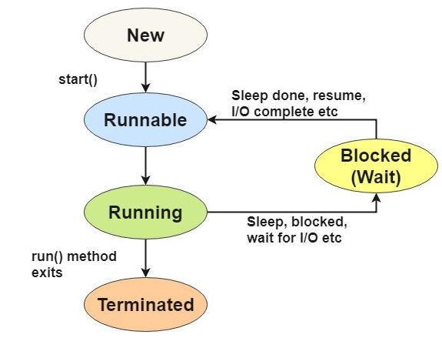

Slide 70
New: Whenever a new thread is created, it is always in the new state. For a thread in the new state, the code has not been run yet and thus has not begun its execution.
Runnable: A thread, that is ready to run is then moved to the runnable state. In the runnable state, the thread may be running or may be ready to run at any given instant of time. It is the duty of the thread scheduler to provide the thread time to run, i.e., moving the thread the running state.
Running: When the thread gets the CPU, it moves from the runnable to the running state. Generally, the most common change in the state of a thread is from runnable to running and again back to runnable.

Slide 71
Blocked or Waiting: Whenever a thread is inactive for a span of time (not permanently) then, either the thread is in the blocked state or is in the waiting state.
Timed Waiting: Sometimes, waiting for leads to starvation. For example, a thread (its name is A) has entered the critical section of a code and is not willing to leave that critical section. In such a scenario, another thread (its name is B) has to wait forever, which leads to starvation. To avoid such scenario, a timed waiting state is given to thread B. Thus, thread lies in the waiting state for a specific span of time, and not forever.
Terminated: A thread reaches the termination state because of the following reasons:1) After Task Completion 2) Due to Abnormal Interput

Slide 72
Thread Life Cycle in Java
try
{
Thread.sleep(1000);
}
catch (InterruptedException e)
{
e.printStackTrace();
}
System.out.println("Thread is in the Timed Waiting state.");
try
{
thread.join();
}
catch (InterruptedException e)
{
e.printStackTrace();
}
System.out.println("Thread is in the Terminated state.");
}
}
public class ThreadLifecycleExample
{
public static void main(String[] args)
{
Thread thread = new Thread();
System.out.println("Thread is running.");
try
{
Thread.sleep(2000);
}
catch (InterruptedException e)
{
e.printStackTrace();
}
System.out.println("Thread is terminating.");
System.out.println("Thread is in the New state.");
thread.start();
System.out.println("Thread is in the Runnable state.");

Slide 73
Java Thread class
Java provides Thread class to achieve thread programming. Thread class provides constructors and methods to create and perform operations on a thread. Thread class extends Object class and implements Runnable interface.
Java Thread Methods
void start() It is used to start the execution of the thread.
void run() It is used to do an action for a thread.
static void sleep() It sleeps a thread for the specified amount of time.
static Thread currentThread() It returns a reference to the currently executing thread object.
void join() It waits for a thread to die.

Slide 74
int getPriority() It returns the priority of the thread.
void setPriority() It changes the priority of the thread.
String getName() It returns the name of the thread.
void setName() It changes the name of the thread.
long getId() It returns the id of the thread.
boolean isAlive() It tests if the thread is alive.
static void yield() It causes the currently executing thread object to pause and allow other threads to execute temporarily.

Slide 75
void suspend() It is used to suspend the thread.
void resume() It is used to resume the suspended thread.
void stop() It is used to stop the thread.
void destroy() It is used to destroy the thread group and all of its subgroups.
void notify() It is used to give the notification for only one thread which is waiting for a particular object.
void notifyAll() It is used to give the notification to all waiting threads of a particular object.

Slide 76
Thread Scheduler in Java:
JVM implements one of the following scheduling strategies
• Preemptive scheduling: If a thread with a higher priority than the current running thread, then the current running thread is preempted(moves to the ready-to-run state) to let the higher priority thread execute.
• Time-sliced or Round-Robin scheduling: A running thread is allowed to execute for a fixed length of time, after which it moves to the Ready-to-run state to wait its turn to run again

Slide 77
Thread Priority in Java:
Priority means the number of resources allocated to a particular thread. Every thread created in JVM is assigned a priority. The priority range is between 1 and 10.
1. 1 is called minimum priority
2. 5 is called normal priority
3. 10 is called maximum priority
The default priority of the main thread is 5.
1. Thread.MIN_PRIORITY;
2. Thread.NORM_PRIORITY;
3. Thread.MAX_PRIORITY;

Slide 78
public class ThreadPriority extends Thread
{
public void run ()
{
System.out.println ("running thread name is:" + Thread.currentThread ().getName ());
System.out.println ("running thread priority is:" + Thread.currentThread ().getPriority ());
}
public static void main (String args[])
{
ThreadPriority m1 = new ThreadPriority ();
ThreadPriority m2 = new ThreadPriority ();
m1.setPriority (Thread.MIN_PRIORITY);
m2.setPriority (Thread.MAX_PRIORITY);
m1.start ();
m2.start ();
}
}
running thread name is:Thread-0
running thread name is:Thread-1
running thread priority is:1
running thread priority is:10

Slide 79
Thread Synchronization in Java
Thread Synchronization is a process of allowing only one thread to use the object when multiple threads are trying to use the particular object at the same time.
To achieve this Thread Synchronization we have to use a java keyword or modifier called “synchronized”. Synchronization in java is the capability to control the access of multiple threads to any shared resource. Java Synchronization is a better option where we want to allow only one thread to access the shared resource.

Slide 80
General Syntax:
synchronized(objectidentifier)
{
// Access shared variables and other shared resources;
}
Why use Synchronization?
The synchronization is mainly used to :
1. If you start with at least two threads inside a program, there might be a chance when multiple threads attempt to get to the same resource.
2. It can even create an unexpected outcome because of concurrency issues.

Slide 81
Types of Synchronization
There are basically two types of synchronization available. They are:
1. Process Synchronization: It means sharing system resources by processes in such a way that, Concurrent access to shared data is handled thereby minimizing the chance of inconsistent data.
2. Thread Synchronization: It means that every access to data shared between threads is protected so that when any thread starts operation on the shared data,no other thread is allowed access until the first thread is done.

Slide 82
Thread Synchronization
There are two types of thread synchronization mutual exclusive and inter-thread communication.
1)Mutual Exclusive
a) Synchronized method.
b) Synchronized block.
c) Static synchronization.
2) Cooperation (Inter-thread communication in java)

Slide 83
Mutual Exclusive
Mutual Exclusive helps keep threads from interfering with one another while sharing data. It can be achieved by using the following three ways:
By Using Synchronized Method
By Using Synchronized Block
By Using Static Synchronization

Slide 84
Thread Synchronization using Synchronized Method in Java:
Method level synchronization is used for making a method code thread-safe, i.e. only one thread must be executing this method code.
Syntax :
<access modifier> synchronized method ( parameter)
{
//synchronized code
}
In the case of the synchronized method, the lock object is:
1. class object – if the given method is static.
2. this object – if the method is non-static. ‘this’ is the reference to the current object
in which the synchronized method is invoked

Slide 85
class multd1 implements Runnable
{
int count=0;
public void run()
{
for(int i=1;i<=100;i++)
{
count++;
}
}
}
catch(Exception e)
{
e.printStackTrace();
}
System.out.println(m1.count);
}
}
class mulsyn{
public static void main(String[] args)
{
multd1 m1=new multd1();
Thread t1=new Thread(m1);
Thread t2=new Thread(m1);
t1.start();
t2.start();
try{
t1.join();
}
Output
100
200
50

Slide 86
public class Synchronization implements Runnable
{
int tickets = 3;
static int i = 1, j = 2, k = 3;
synchronized void bookticket (String name, int wantedtickets)
{
if (wantedtickets <= tickets)
{
System.out.println (wantedtickets + " booked to " + name);
tickets = tickets - wantedtickets;}
else
{
System.out.println ("No tickets to book");
}
}
else if (name.equals ("t2"))
{
bookticket (name, j);
}
else
{
bookticket (name, k);
}
}
public static void main (String[]args)
{
Synchronization s = new Synchronization ();
Thread t1 = new Thread (s);
Thread t2 = new Thread (s);
Thread t3 = new Thread (s);
t1.setName ("t1");
t2.setName ("t2");
t3.setName ("t3");
t1.start ();
t2.start ();
t3.start ();
}
}
public void run ()
{
String name = Thread.currentThread ().getName ();
if (name.equals ("t1"))
{
bookticket (name, i);
}
1 booked to t1
No tickets to book
2 booked to t2

Slide 87
Thread Synchronization using Synchronized Block in Java:
Block-level synchronization is used for making some amount of method code thread-safe.If we want to synchronize access to an object of a class or only a part of a method to be synchronized then we can use the synchronized block for it. It is capable to make any part of the object and method synchronized.
Syntax:
synchronized (object reference expression) {
//code block
}
class SynchroBlock
{
public static void main (String[]args)
{
A a1 = new A ();
Thread t1 = new Thread (a1);
Thread t2 = new Thread (a1);
Thread t3 = new Thread (a1);
t1.setName ("t1");
t2.setName ("t2");
t3.setName ("t3");
t1.start ();
t2.start ();
t3.start ();
}
}
class A implements Runnable
{
int token = 1;
public void run ()
{
synchronized (this)
{
Thread t = Thread.currentThread ();
String name = t.getName ();
System.out.println (token + ".....alloted to " + name);
token++;
} } }
1.....alloted to t1
2.....alloted to t3
3.....alloted to t2

Slide 88
Inter-Thread Communication (Cooperation) in Java:
It is a mechanism of communication between two threads or multiple threads that acts on the common object (owner). To perform the multiple actions at a time we need Inter-thread communication.
For example online video players, audio players, etc. In both types of players generally,there are two types of threads: Buffer Thread and Playing Thread.
The buffer Thread is responsible to download content from the server into a buffer memory and whereas the playing thread is responsible to play content and these actions will be done based on thread communication only

Slide 89
Cooperation (Inter-thread communication) is a mechanism in which a thread is paused running in its critical section and another thread is allowed to enter (or lock) in the same critical section to be executed.It is implemented by following methods of Object class:
1) wait() method
The wait() method causes current thread to release the lock and wait until either another thread invokes the notify() method or the notifyAll() method for this object, or a specified amount of time has elapsed.
The current thread must own this object's monitor, so it must be called from the synchronized method only otherwise it will throw exception.

Slide 90
Method Description
public final void wait()throws InterruptedException
It waits until object is notified.
public final void wait(long timeout)throws InterruptedException
It waits for the specified amount of time.
2) notify() method
The notify() method wakes up a single thread that is waiting on this object's monitor. If any threads are waiting on this object, one of them is chosen to be awakened.
public final void notify()

Slide 91
3) notifyAll() method
Wakes up all threads that are waiting on this object's monitor.
public final void notifyAll()

Slide 92
synchronized void deposit(int amount){
System.out.println("going to deposit...");
this.amount+=amount;
System.out.println("deposit completed... ");
notify();
}
}
class Test{
public static void main(String args[]){
final Customer c=new Customer();
new Thread(){
public void run(){c.withdraw(15000);}
}.start();
new Thread(){
public void run(){c.deposit(10000);}
}.start();
}}
class Customer{
int amount=10000;
synchronized void withdraw(int amount){
System.out.println("going to withdraw...");
if(this.amount<amount){
System.out.println("Less balance; waiting for deposit...");
try{wait();}catch(Exception e){}
}
this.amount-=amount;
System.out.println("withdraw completed...");
}

Slide 93
Difference between wait and sleep?
Let's see the important differences between wait and sleep methods.
wait() sleep()
The wait() method releases the lock. The sleep() method doesn't release the lock.
It is a method of Object class It is a method of Thread class
It is the non-static method It is the static method
It should be notified by notify()
or notifyAll() methods After the specified amount of time, sleep is completed.

